Slide 1
“Compiler Design
CSIT 5rd
Semester

Slide 2
Introduction
The lexical analysis is the first phase of a compiler where a lexical analyzer acts as an interface between the source program and the rest of the phases of compiler.
It reads the input characters of the source program, groups them into lexemes, and produces a sequence of tokens for each lexeme.
The tokens are then sent to the parser for syntax analysis. Normally a lexical analyzer doesn‟t return a list of tokens; it returns a token only when the parser asks a token from it.
Lexical analyzer may also perform other auxiliary operation like removing redundant white space, removing token separator (like semicolon) etc.

Slide 3
2
Example: Example of Lexical Analysis, Tokens, Non-Tokens Consider the following code that is fed to Lexical Analyzer
#include <stdio.h>
int Largest(int x, int y)
{
// This will compare 2 numbers if (x > y)
return x; else
return y;
}

Slide 4
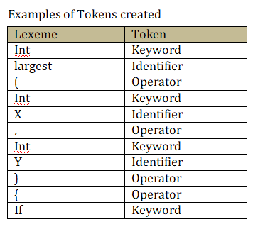

Slide 5
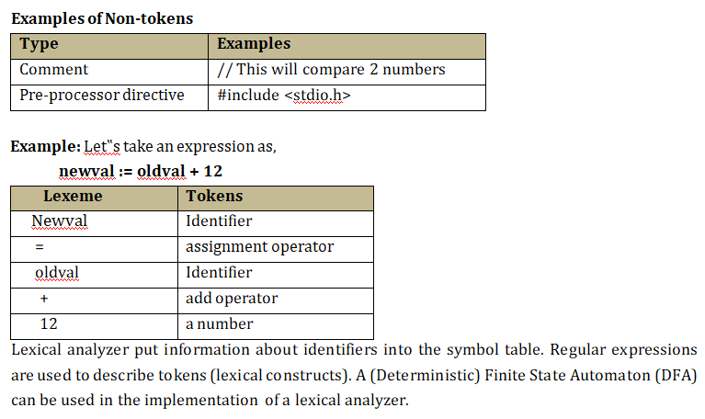

Slide 6
Role of Lexical Analyzer:
It is the first phase of a compiler
It reads the input character and produces output sequence of tokens that the Parser uses for syntax analysis.
Lexical analyzer helps to identify token into the symbol table
It can either work as a separate module or as a sub-module.
Lexical Analyzer is also responsible for eliminating comments and white spaces from the source program.
It also generates lexical errors.
Lexical analyzer is used by web browsers to format and display a web page with the help of parsed data from JavsScript, HTML, CSS

Slide 7
Lexical analysis phase errors
The lexical analyzer must be able to cope with text that may not be lexically valid. For example
A number may be too large
A string may be too long or identifier may be too long
A number may be incomplete
The final quote on a sting may be missing
The end of a comment may be missing
A special symbol may be incomplete
Invalid character may appear in the text
Compiler directives may be invalid etc.

Slide 8
Lexemes
A lexeme is a sequence of alphanumeric characters that is matched against the pattern for a token.
A sequence of input characters that make up a single token is called a lexeme.
A token can represent more than one lexeme. The token is a general class in which lexeme belongs to.
Example: The token “String constant” may have a number of lexemes such as “bh”, “sum”, “area”, “name” etc.
Thus lexeme is the particular member of a token which is a general class of lexemes.

Slide 9
Input Buffering
Reading character by character from secondary storage is slow process and time consuming as well.
It is necessary to look ahead several characters beyond the lexeme for a pattern before a match can be announced.
One technique is to read characters from the source program and if pattern is not matched then push look ahead character back to the source program.
This technique is time consuming. Use buffer technique to eliminate this problem and increase efficiency.
The lexical analyzer scans the input from left to right one character at a time. It uses two pointers begin ptr (bp) and forward to keep track of the pointer of the input scanned.
Initially both the pointers point to the first character of the input string as shown below,

Slide 10
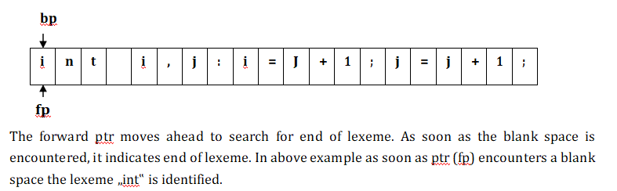

Slide 11
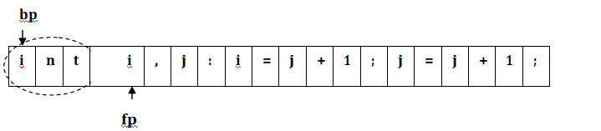
The fp will be moved ahead at white space, when fp encounters white space, it ignores and moves ahead.
Then both the begin ptr (bp) and forward ptr (fp) are set at next token.
The input character is thus read from secondary storage, but reading in this way from secondary storage is costly.
Hence buffering technique is used.
A block of data is first read into a buffer, and then second by lexical analyzer. There are two methods used in this context:
One Buffer Scheme, and Two Buffer Scheme. These are explained as following below.

Slide 12
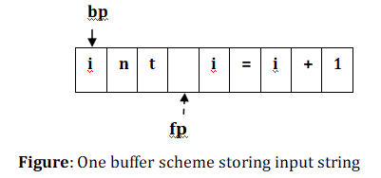
One Buffer Scheme
In this scheme, only one buffer is used to store the input string but the problem with this scheme is that if lexeme is very long then it crosses the buffer boundary, to scan rest of the lexeme the buffer has to be refilled, that makes overwriting the first of lexeme.

Slide 13
Two Buffer Scheme
To overcome the problem of one buffer scheme, in this method two buffers are used to store the input string.
The first buffer and second buffer are scanned alternately. When end of current buffer is reached the other buffer is filled.
The only problem with this method is that if length of the lexeme is longer than length of the buffer then scanning input cannot be scanned completely.
Initially both the bp and fp are pointing to the first character of first buffer.
Then the fp moves towards right in search of end of lexeme. As soon as blank character is recognized, the string between bp and fp is identified as corresponding token.
To identify, the boundary of first buffer end of buffer character should be placed at the end first buffer.

Slide 14
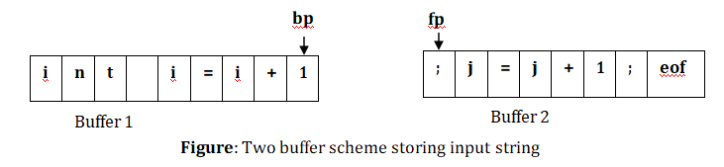
2
Similarly end of second buffer is also recognized by the end of buffer mark present at the end of second buffer.
When fp encounters first eof, then one can recognize end of first buffer and hence filling up second buffer is started.
In the same way when second eof is obtained then it indicates of second buffer.
Alternatively both the buffers can be filled up until end of the input program and stream of tokens is identified.
This eof character introduced at the end is calling Sentinel which is used to identify the end of buffer.

Slide 15
22
Specifications of Tokens
Regular expressions are an important notation for specifying patterns.
Each pattern matches a set of strings, so regular expressions will serve as names for sets of strings.
In brief a regular expression is a way to specify tokens. The regular expression represents the regular languages.
The language is the set of strings and string is the set of alphabets. Thus following terminologies are used to specify tokens:
  Alphabets, Strings and Languages
  Operations on languages
  Regular expressions
  Regular definition

Slide 16
Alphabets
The set of symbols is called alphabets. Example any finite set of symbols ∑= {0,1} is a set of binary alphabets, ∑={0,1,2,3,4,5,6,7,8,9,A,B,C,D,E,F} is a set of Hexadecimal alphabets, ∑={a-z, A-Z} is a set of English language alphabets.
Strings
Any finite sequence of alphabets is called a string. Length of the string is the total number of occurrence of alphabets, e.g., the length of the string „Kanchanpur‟ is 10 and is denoted by
|Kanchanpur|=10. A string having no alphabets, i.e. a string of zero length is known as an empty string and is denoted by ε (epsilon).

Slide 17
22
Language
A language is considered as a finite set of strings over some finite set of alphabets.
Computer languages are considered as finite sets, and mathematically set operations can be performed on them.
Finite languages can be described by means of regular expressions.
Operations on languages
The following are the operations that can be applied to languages:
Union
Concatenation
Kleene closure
Positive closure

Slide 18
2222
Union
The symbol 𝖴 is employed to denote the union of two sets.
Thus, the set A𝖴B read “A union B” or “the union of A and B” is defined as the set that consists of all elements belonging to either set A or set B (or both).
In regular expression plus (+) symbol is used to represent union operation. Let A and B be two languages, where A = {dog, ba, na} and B = {house, ba} then,
AUB = A+B=A|B = {dog, ba, na, house}
Concatenation
String concatenation is the operation of joining character strings end-to-end.
In regular expression dot operator (.) is used to represent concatenation operation.
Example: A.B = {doghouse, dogba, bahouse, baba, nahouse, naba}

Slide 19
Kleene Closure
The Kleene closure, ∑*, is a unary operator on a set of symbols or strings, ∑, that gives the infinite set of all possible strings of all possible lengths over ∑ including {Φ}.
Mathematically, ∑* = ∑0 𝖴 ∑1 𝖴 ∑2 𝖴……. where ∑n is the set of all possible strings of length n.
Example: If ∑ = {a, b} then,
∑* = {Φ, a, b, aa, ab, ba, bb, aaa, aba, bab, aab, bba, bbb,…….}
a* = {a0 U a1 U a2 U a3 U…..an}={Φ, a, aa, aaa, aaaa, aaaaa, }
b* ={b0 U b1 U b2 U b3 U…..bn}={Φ, b, bb, bbb, bbbb, bbbbb, }
a.b* = {a}. {Φ, b, bb, bbb, bbbb, bbbbb, }
{a, ab, abb, abbb, abbbb, abbb }
(ab)* = ={(ab)0 U (ab)1 U (ab)2 U (ab)3 U…..(ab)n}={Φ, ab, abab, ababab, }
a*.b* = {Φ, a, aa, aaa, aaaa, aaaaa, …..}. {Φ, b, bb, bbb, bbbb, bbbbb,. }
= {Φ, b, bb, bbb, bbbb, bbbbb, a, ab, abb, abbb, abbbb, abbbbb, aa, aab, aabb, aabbb, aaa, aaab, aaabb, }
(a+b)* = {Φ, a, b, aa, aaa, aaaa, bb, bbb, bbbb, ab, ba, abababa, bababa, aaaab, baaaa, }

Slide 20
Positive closure
The set ∑+ is the infinite set of all possible strings of all possible lengths over ∑ excluding {Φ}. Mathematically, ∑+ = ∑1 𝖴 ∑² 𝖴 ∑³ 𝖴 where ∑n is the set of all possible strings of length n.
Example: If ∑ = {a, b} then,
∑+ = ∑* − {Φ}
∑+ = {a, b, aa, ab, ba, bb, aaa, aba, bab, aab, bba, bbb, }
a+ = {a1 U a2 U a3 U…..an}={a, aa, aaa, aaaa, aaaaa, }
b+ = {b1 U b2 U b3 U…..bn}={b, bb, bbb, bbbb, bbbbb, }
a.b+ = {a}.{b, bb, bbb, bbbb, bbbbb, }
= {ab, abb, abbb, abbbb, abbb }
(ab)+ = {(ab)1 U (ab)2 U (ab)3 U…..(ab)n}={ab, abab, ababab, abababab }
a+.b+ = {a, aa, aaa, aaaa, aaaaa, …….}.{b, bb, bbb, bbbb, bbbbb, }
= {ab, abb, abbb, abbbb, aab, aabb, aabbb, aabbbb, aaab, aaabb, aaabbb }
(a+b)+ = {a, b, aa, aaa, aaaa, bb, bbb, bbbb, ab, ba, abababa, bababa, aaaab, baaaa,……}

Slide 21
Regular Expressions
Regular expressions are the algebraic expressions that are used to describe tokens of a programming language. It uses the three regular operations. These are called union/or, concatenation and star. Brackets ( and ) are used for grouping, just as in normal math.
Examples: Given the alphabet A = {0, 1}
1(1+0)*0 denotes the language of all string that begins with a „1‟ and ends with a „0‟.
(1+0)*00 denotes the language of all strings that ends with 00 (binary number multiple of 4)
(01)*+ (10)* denotes the set of all stings that describe alternating 1s and 0s
(0* 1 0* 1 0* 1 0*) denotes the string having exactly three 1‟s.
1*(0+ ε)1*(0+ ε) 1* denotes the string having at most two 0‟s

Slide 22
(A | B | C |………| Z | a | b | c |………| z | _ |). (A | B | C |………| Z | a | b | c
|………| z | _ | 1 | 2 | | 9)* denotes the regular expression to specify the identifier like programming in C.
(1+0)* 001 (1+0)* denotes string having substring 001
0(0 + 1)∗ 0 + 1(0 + 1)∗1 denotes the RE for the language of all binary strings of length at least 2 that begin and end in the same symbol.
((0 + 1)∗ 1 + ε) (00)∗ 00 denotes the RE for the set of all binary strings that end with an even nonzero number of 0‟s.
Regular expression for declaration of valid one dimensional array in programming like C
∑= (0,1…..9,a,b…z, A, B Z,_,[,])
RE: (a|b|…..|z|A|B|….|Z|_) (a|b|…..z|A |B|….|Z|_|0|1|…|9)* . [(1|2|….|9) (0|1|2|….|9)* ]

Slide 23
Regular Definitions
To write regular expression for some languages can be difficult, because their regular expressions can be quite complex.
In those cases, we may use regular definitions. Giving names to regular expressions is referred to as a Regular definition.
If Σ is an alphabet of basic symbols, then a regular definition is a sequence of definitions of the form,
d1 → r1 d2 → r2
…………….
d_{n} → r_{n}
Where, di is a distinct name and ri is a regular expression over symbols in Σ 𝖴 {d1, d2 di-1}
Σ = Basic symbol and {d1, d2... di-1} = previously defined names.

Slide 24
Example 1: Regular definition for specifying identifiers in a programming language like C letter → A | B | C |………| Z | a | b | c |………| z
underscore →‟_‟
digit → 0 | 1 | 2 | | 9
id → (letter | underscore).(letter | underscore | digit)*
If we are trying to write the regular expression representing identifiers without using regular definition, it will be complex.
(A | B | C |………| Z | a | b | c |………| z | _ |). ((A | B | C |………| Z | a | b | c |………
| z | _ |) (1 | 2 | | 9))*

Slide 25
Example 2: Write regular definition for specifying floating point number in a programming language like C
digit → 0 | 1 | 2 | | 9
num→ digit * (.) (digit)+
Example 3: Write regular definitions for specifying an integer one dimensional array declaration in programming language like in C
Lc → a|b| |z
Uc → A|B| |Z
Digit →1|2| |9
Zero → 0 Us →_ Lb → [ Rb →]
Array → (Lc|Uc|Us) (Lc|Uc|Us|Digit|zero)* Lb. Digit.(Digit|zero)* Rb

Slide 26
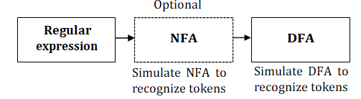
Design of a Lexical Analyzer
First, we define regular expressions for tokens; then we convert them into a DFA to get a lexical analyzer for our tokens.
Algorithm1: Regular Expression → NFA → DFA (two steps: first to NFA, then to DFA)
Algorithm2: Regular Expression → DFA (directly convert a regular expression into a DFA)
The finite automat is used to recognize the token. An automaton with a finite number of states is called a Finite Automaton (FA) or Finite State Machine (FSM).

Slide 27
Formal definition of a Finite Automaton
An automaton can be represented by a 5-tuple (Q, ∑, δ, q0, F), Where,
  Q is a finite set of states.
  ∑ is a finite set of symbols, called the alphabet of the automaton.
  δ is the transition function.
  q0 is the initial state from where any input is processed (q0 ∈ Q).
  F is a set of final state/states of Q (F ⊆ Q).
Finite Automaton can be classified into two types:
  Deterministic Finite Automaton (DFA)
  Non-deterministic Finite Automaton (NDFA / NFA)

Slide 28
Non-Deterministic Finite Automaton (NFA)
In NFA, for a particular input symbol, the machine can move to any combination of the states in the machine.
In other words, the exact state to which the machine moves cannot be determined. Hence, it is called Non-deterministic Automaton.
FA is non deterministic, if there is more than one transition for each (state, input) pair. It is slower recognizer but it make take less spaces. An NFA is a 5-tuple (Q, Σ, δ, q0, F) where,
  Q is a finite set of states
  Σ is a finite set of symbols
  δ is a transition function
  q0 ∈ Q is the start state
  F ⊆ Q is the set of accepting (or final) states
A NFA accepts a string x, if and only if there is a path from the starting state to one of accepting states.

Slide 29
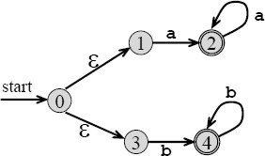
ε- NFA
In NFA if a transition made without any input symbol then this type of NFA is called ε-NFA.
Here we need ε-NFA because the regular expressions are easily convertible to ε-NFA.
Fig: - ε-NFA for regular expression aa* +bb*

Slide 30
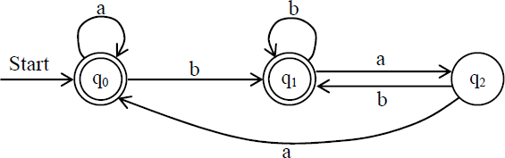
Deterministic Finite Automaton (DFA)
DFA is a special case of NFA.
There is only difference between NFA and DFA is in the transition function.
In NFA transition from one state to multiple states take place while in DFA transition from one state to only one possible next state take place.
Example 1: DFA that accepts all the strings over Σ = {a, b} that do not end with ba

Slide 31
Conversion: Regular Expression to NFA
Thomson’s Construction
Thomson‟s Construction is simple and systematic method.
It guarantees that the resulting NFA will have exactly one final state, and one start state.
It is a process in bottom up manner by creating ε-NFA for each symbol including.
Then recursively create for other operations as shown below,
Method
  First parse the regular expression into sub-expressions
  Construct NFA‟s for each of the basic symbols in regular expression (r)
  Finally combine all NFA‟s of sub-expressions and we get required NFA of given regular expression.

Slide 32


To recognize an empty string ε
To recognize a symbol a in the alphabet Σ

Slide 33

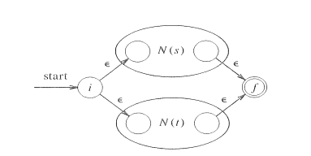
If N (r1) and N (r2) are NFAs for regular expressions r1 and r2
a. For regular expression r1 + r2
b. For regular expression r1 r2

Slide 34
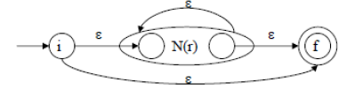
c. For regular expression r*

Slide 35
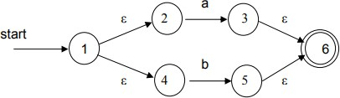
Using rule 1 and 2 we construct NFA‟s for each basic symbol in the expression, we combine these basic NFA using rule 3 to obtain the NFA for entire expression.
Example 1: NFA construction of RE (a + b) * abb
the NFA‟s for single character regular expressions ε, a, b
The NFA for the union of „a‟ and „b‟: a|b is constructed from the individual NFA‟s using the ε NFA as „glue‟.
Remove the individual accepting states and replace with the overall accepting state,

Slide 36
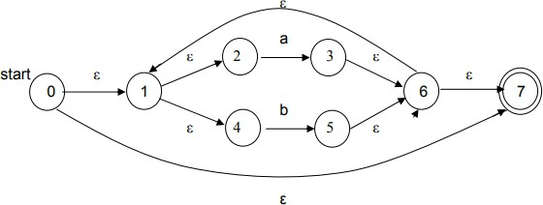
Kleene closure on (a|b)*. The NFA accepts ε in addition to (a|b)*

Slide 37
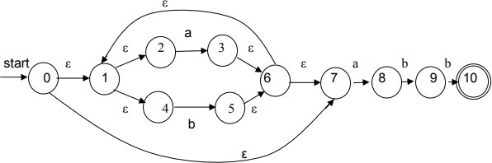
concatenate with abb

Slide 38
Conversion from NFA to DFA
A Deterministic Finite Automaton (DFA) has at most one edge from each state for a given symbol and is a suitable basis for a transition table.
We need to eliminate the ε-transitions by subset construction.
Subset Construction Algorithm
Put ε-closure (s0) as an unmarked state in to Dstates
  While there is an unmarked state T in Dstates do
mark T
for each input symbol a ∈ Σ do
U = ε-closure (move (T, a))
if U is not in Dstates then
Add U as an unmarked state to Dstates
end if
Dtran[T, a] = U
end do
end do

Slide 39
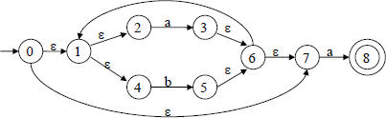
Example 1: At first construct NFA of RE (a+b)*a then convert resulting NFA to DFA.
Solution: The NFA of Given RA is given below,

Slide 40
Now convert above NFA to DFA as,
The starting state of DFA = S0 = ε-closure (Starting state of NFA) = ε-closure ({0}) = {0, 1, 2, 4, 7} S0 = {0, 1, 2, 4, 7}
Mark S0,
For a: ε-closure (move (S0, a)) = ε-closure (3, 8) = {1, 2, 3, 4, 6, 7, 8}->S1
For b: ε-closure (move (S0, b)) = ε-closure (5) = {1, 2, 4, 5, 6, 7}->S2
Mark S1,
For a: ε-closure (move (S1, a)) = ε-closure (3, 8) = {1, 2, 3, 4, 6, 7, 8}->S1
For b: ε-closure (move (S1, b)) = ε-closure (5) = {1, 2, 4, 5, 6, 7}->S2

Slide 41
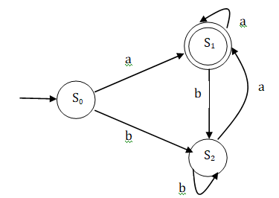
Mark S2,
For a: -closure (move (S2, a)) = -closure (3, 8) = {1, 2, 3, 4, 6, 7, 8}->S1
For b: -closure (move (S2, b)) = -closure (5) = {1, 2, 4, 5, 6, 7}->S2
S0 is the start state of DFA since 0 is a member of S0= {0, 1, 2, 4, 7}
S1 is an accepting state of DFA since final state of NFA i.e. 8 is a member of S1 = {1, 2, 3, 4, 6, 7, 8} Now construct DFA from above informations as,

Slide 42
Example 2: At first construct NFA of RE (a+b)*abb then convert resulting NFA to DFA.

